Slide 1
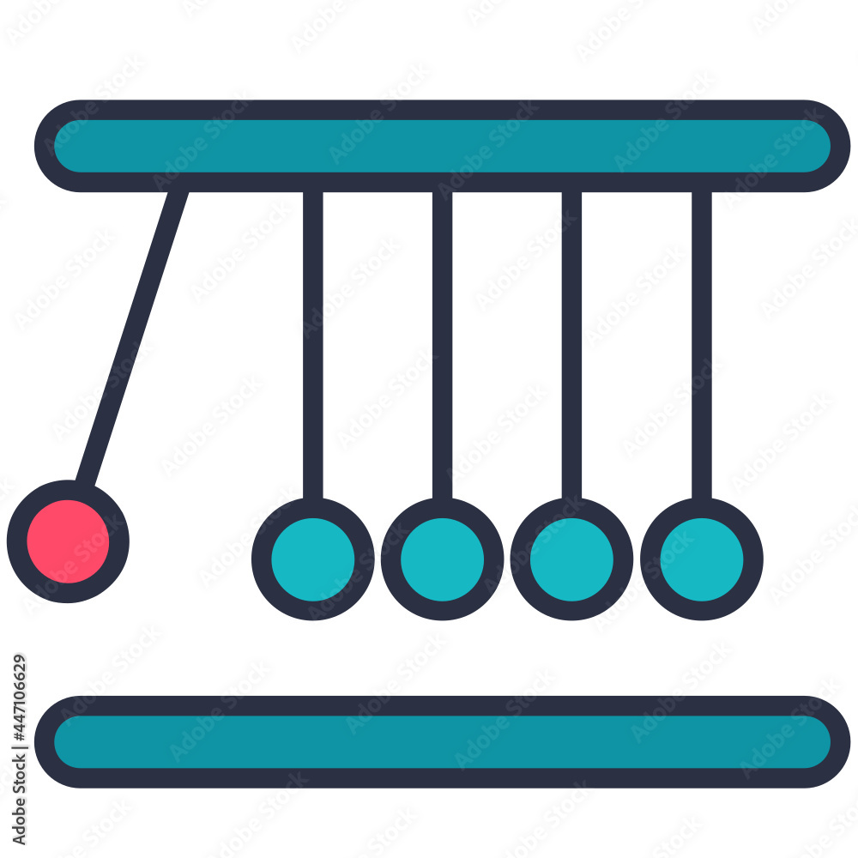
IBM Research Technical Workshop Causal Inference with causallib March 27, 2024 Ehud Karavani Research Staff Member

Slide 2
Outline
Motivation - why causation?
Introduction - what is causation
Identification - when correlation implies causation
Estimation - obtaining these correlations
Evaluation - how accurate are these correlations
Causallib - how to estimate and evaluate these in Python
Hands-on demo - estimate and evaluate these in practice in Python
Questions and discussion

Slide 3
Outline
Motivation - why causation?
Introduction - what is causation
Estimation - estimating treatment effects
Causallib - estimating treatment effects in Python
Hands-on demo - estimating treatment effects in practice in Python
Questions
Identification - when are these treatment effects truly causal
Evaluation - how accurate are these effects
Discussion
Part 1
Part 2
Part 3

Slide 4
Outline
Motivation - why causation?
Introduction - what is causation
Estimation - estimating treatment effects
Causallib - estimating treatment effects in Python
Hands-on demo - estimating treatment effects in practice in Python
Questions
Identification - when are these treatment effects truly causal
Discussion
Part 1
Part 2
Part 3

Slide 5
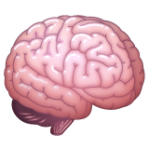
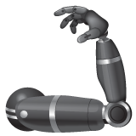

Hierarchy of data-driven tasks
Prescriptive
What’s the risk for stroke if people take statins?
Predictive
What’s the risk for stroke?
Human interest
Descriptive
How many people have suffered a stroke in 2023?
Difficulty
Judea Pearl’s ladder of causation
Hernán et al. Classification of Data Science Tasks
Notes:
Descriptive tells us about the current state
Prediction tells us about the future
Prescriptive tells us about possible different futures

Slide 6
Hierarchy of data-driven tasks
Prescriptive
What’s the risk for stroke if people take statins?
Predictive
What’s the risk for stroke?
Human interest
“Ok, now what?”
Descriptive
How many people have suffered a stroke in 2023?
Difficulty
Judea Pearl’s ladder of causation
Hernán et al. Classification of Data Science Tasks
Notes:
Prescriptive > predictive: once we know we’re in risk, it’s very human of us to want to mitigate it.
What will be my risk if I’ll start take statins, start exercise, change my diet.

Slide 7
What’s the risk for stroke if people take statins?
“What is the risk for stroke if they wouldn’t take statins?”

Slide 8
Causal Inference – The Task
Quantifying the causal effect of a prespecified intervention on a prespecified outcome.
“What is the risk for stroke if they wouldn’t take statins?”
Disentangle spurious correlations from causal contributions
Notes:
the impact of an action of interest on an outcome we care about.

Slide 9
Causal Inference – The Task
Quantifying the causal effect of a prespecified intervention on a prespecified outcome.
“What is the risk for stroke if they wouldn’t take statins?”
Disentangle spurious correlations from causal contributions
Notes:
the impact of an action of interest on an outcome we care about.

Slide 10
Causal Inference – The Task
Quantifying the causal effect of a prespecified intervention on a prespecified outcome.
“What is the risk for stroke if they wouldn’t take statins?”
Disentangle spurious correlations from causal contributions
Notes:
the impact of an action of interest on an outcome we care about.

Slide 11
Causality – A Road Map
Causality
Causal Discovery
What caused the outcome? Why?
Causal Inference
Quantify impact of a prespecified cause of interest
?
?
?
?
?
Notes:
What we mean when we say “causal inference”.
Left: inferring the graph.
Right: given the graph, put weights on its edges.

Slide 12
Causal Inference – How
Conceptually, to quantify the causal effect:
Compare
what would have happened if we did something
to
what would have happened if we did nothing

Slide 13

Causal Inference by counterfactual prediction
Ideally,
The Multiverse!
Universe splits just before intervention is administrated

Slide 14


Causal Inference by counterfactual prediction
Ideally,
The Multiverse!
Universe splits just before intervention is administrated
The rest is identical
“Effect” is then the contrast between two worlds:
-
/
Notes:
in one we intervene on and on the other we do not. and the rest is identical. So every downstream difference you observe between the universes must be due to the intervention we administered.

Slide 15



Causal Inference by counterfactual prediction
We have no access to the multiverse ☹
In observational settings we can only have those who were actually treated and those who were not
But these may be a poor substitute to the hypothetical measurements of what would have happen if everyone would have been treated and not treated.
Notes:
Unfortunately
Observational settings: we just passively watch/record the real world

Slide 16

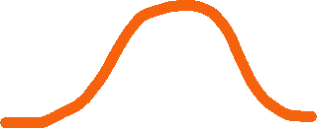



Problem: confoundedness
We want to find whether proactive outreach from the bank to customers with overdue payments increases their likelihood to pay
Descriptive statistics task:
Query the DB for clients who got called from the bank
Query the DB for clients who did not get called from the bank
Compare the repayment probability of the two groups
Treated
Untreated
Treated
Debt payment
Average “effect”
Untreated
Days late
Days late
Notes:
people who are delinquent on their loan
late-paying

Slide 17
Problem: confoundedness
Reminder call
Payment
We thought we saw that proactive outreach increased repayment

Slide 18
Problem: confoundedness
Days late
Tellers call as the computer notifies payment is overdue
People only a few days late probably just forgot to pay
Early delinquent payments tend to be paid more
Tellers tend to call early
Reminder call
Payment
Appears to improve repayment when not accounting for how late the late-payers are
Notes:
The outreach might have no effect

Slide 19
Problem: confoundedness
Confounders are variables that affect both the assignment and the outcome
Creating systematic differences between groups
Days late
Tellers call as the computer notifies payment is overdue
People only a few days late probably just forgot to pay
Early delinquent payments tend to be paid more
Tellers tend to call early
Reminder call
Payment
Appears to improve repayment when not accounting for how late the late-payers are

Slide 20


Solving confoundedness
Confounders are variables that affect both the assignment and the outcome
Creating systematic differences between groups
Adjust for all confounding factors to remove all confounding bias
Eliminate the impact of confounders
Isolate the impact of the intervention
Treated
Average effect
Adjust
Debt payment
Debt payment
Average “effect”
Untreated
Days late
Days late
Notes:
Problem: we can never know we adjusted for all confounding factors, and that’s why causal inference from observational data is hard and requires domain expertise in addition to statistical tools.

Slide 21
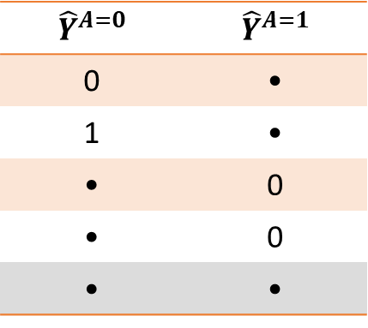
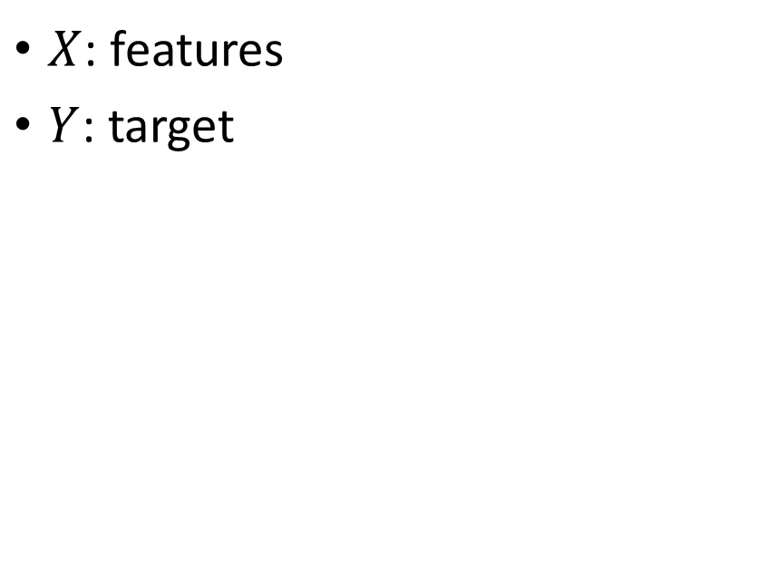
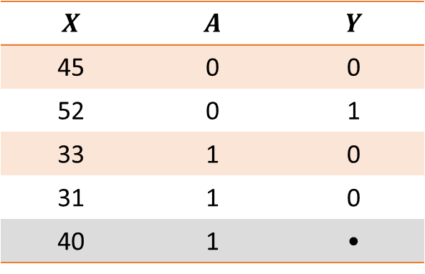
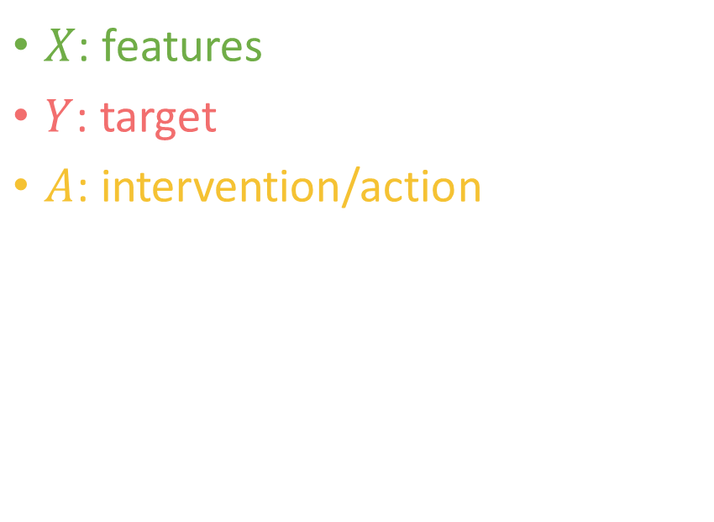
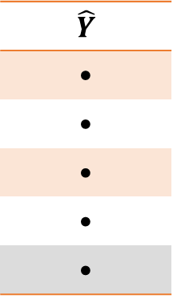
Counterfactual prediction ≠ supervised learning
Supervised learning prediction
Counterfactual prediction
$X$: features
$Y$: target
$X$: features
$Y$: target
$A$: intervention/action
$$X$$ | $$A$$ | $$Y$$
45 | 0 | 0
52 | 0 | 1
33 | 1 | 0
31 | 1 | 0
40 | 1 | •
$$\hat{Y}$$
•
•
•
•
•
$${\hat{Y}}^{A=0}$$ | $${\hat{Y}}^{A=1}$$
0 | •
1 | •
• | 0
• | 0
• | •
■ Test-set
Observed Data
Outcome
Potential Outcome

Slide 22
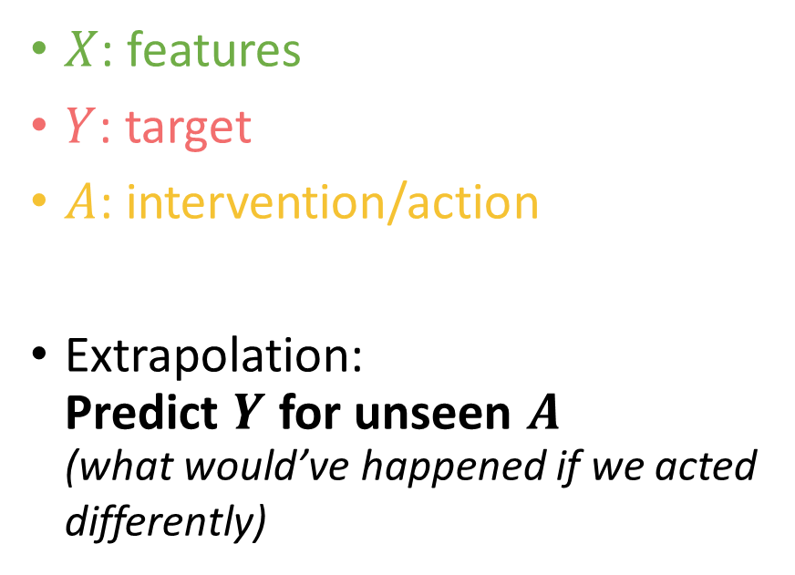
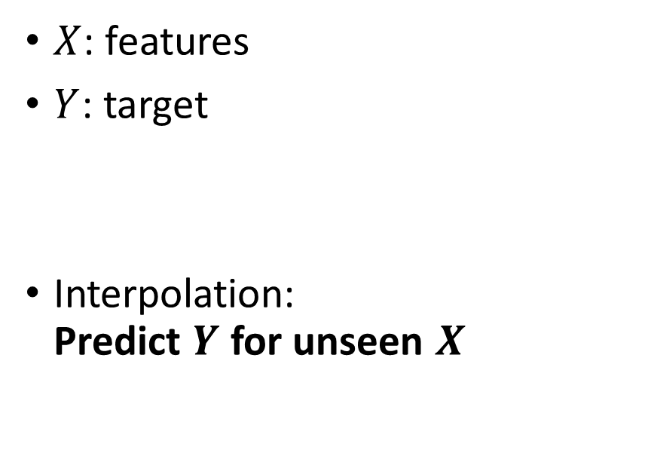
Counterfactual prediction ≠ supervised learning
Supervised learning prediction
Counterfactual prediction
$X$: features
$Y$: target
Interpolation: Predict $Y$ for unseen $X$
$X$: features
$Y$: target
$A$: intervention/action
Extrapolation: Predict $Y$ for unseen $A$ (what would’ve happened if we acted differently)
Notes:
So in regular supervised learning we have features and a target and we use them to predict the target for new unseen samples.
In causal inference we also have actions, and we predict target for unseen actions.

Slide 23

Counterfactual prediction ≠ supervised learning
We predict outcomes of alternate realities
But we can only observe one outcome for each individual, dependent on whether they were intervened on or not
No ground truth labels like in supervised learning
Validation is impossible
“The Fundamental Problem of Causal Inference”
Notes:
Potential outcomes in a quantum super-position until treatment allocation.

Slide 24
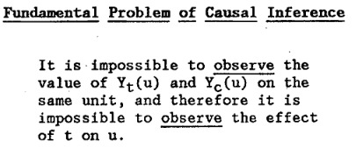
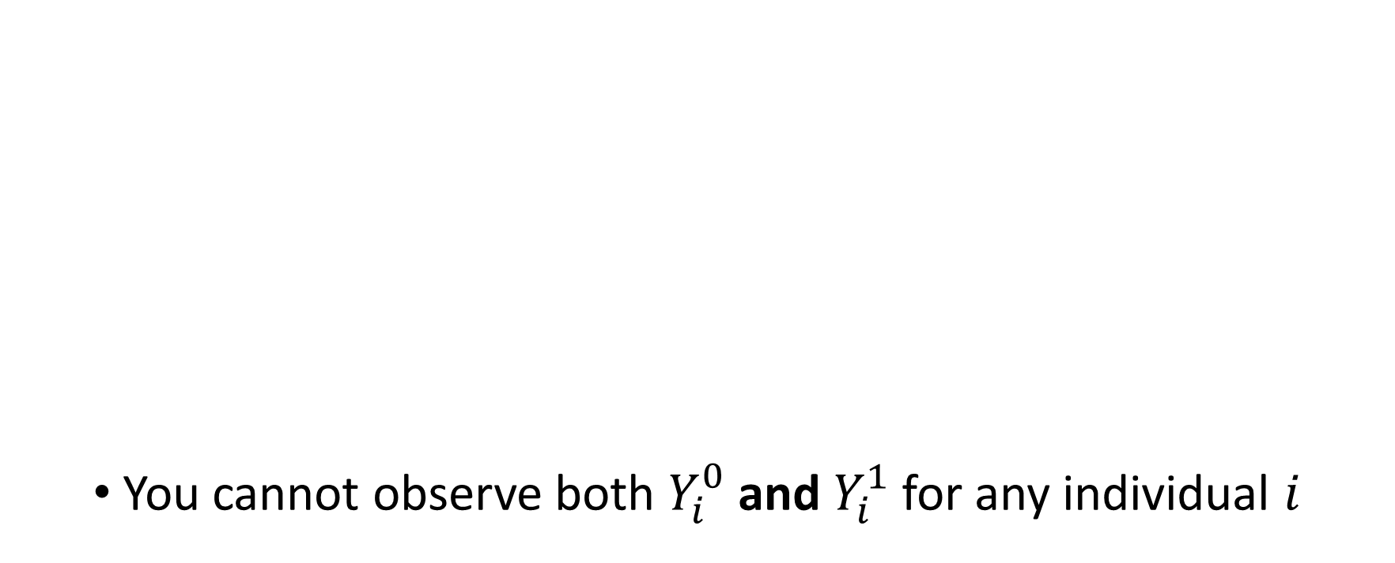
The Fundamental Problem of Causal Inference (Holland 86’)
You cannot observe both $Y_{i}^{0}$ and $Y_{i}^{1}$ for any individual $i$

Slide 25
Estimation
Obtaining data-based correlations that can be interpreted causally

Slide 26
So how can we still estimate causal effect if we can’t learn them directly?

Slide 27
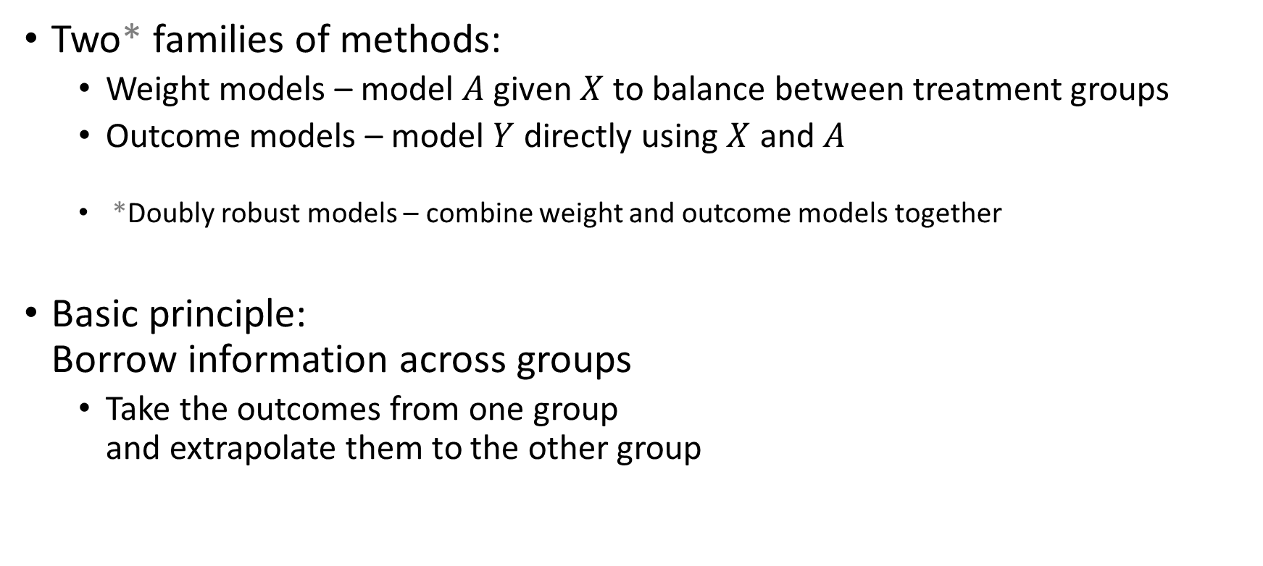
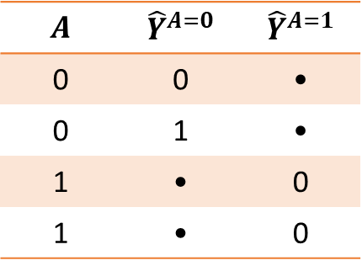
Estimation methods
Two* families of methods:
Weight models – model $A$ given $X$ to balance between treatment groups
Outcome models – model $Y$ directly using $X$ and $A$
*Doubly robust models – combine weight and outcome models together
Basic principle: Borrow information across groups
Take the outcomes from one group and extrapolate them to the other group
$$A$$ | $${\hat{Y}}^{A=0}$$ | $${\hat{Y}}^{A=1}$$
0 | 0 | •
0 | 1 | •
1 | • | 0
1 | • | 0
Potential Outcomes
Notes:
This brings us to estimation methods for causal effects. So how can we make this prediction? Pooling information across groups.
“Those who were actually untreated will tell us what would have happen had the treated been untreated, and the treated will tell us what could have happen had the control units been treated.”

Slide 28










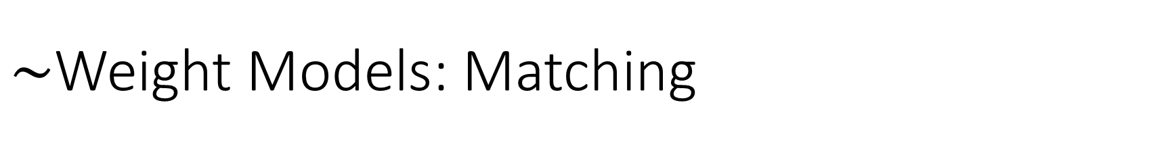
$\sim$Weight Models: Matching
A very popular and intuitive method for adjustment:
For each treated unit find the control most similar to it.
Sick
Healthy
Notes:
The most intuitive example for this type of borrowing is matching
A detour to get to weight model, which is conceptually easy to understand (convincible)

Slide 29




$\sim$Weight Models: Matching
A very popular and intuitive method for adjustment:
For each treated unit find the control most similar to it.
Sick
Healthy
Notes:
Not sample-efficient
Like an IPW with 0-1 weights

Slide 30
$\sim$Weight Models: Matching
Using matching as
a potential outcome prediction model
My counterfactual outcome is sick!
My outcome is sick!

Slide 31
$\sim$Weight Models: Matching
Using matching as
a potential outcome prediction model
a transformer/preprocessor
Gather up, we’re going into regression!
*Match by confounders but use outcome-predicting features for sample efficiency
Notes:
Doubly-robust-like approach
Match by confounders but use outcome-predicting features for sample efficiency

Slide 32
$\sim$Weight Models: Matching
Advantage:
Epistemological: very intuitive / convincing
Notes:
Easy to convince peers.
“this is a person who looks like me (on every measure that counts) only that he or she were not treated”.

Slide 33
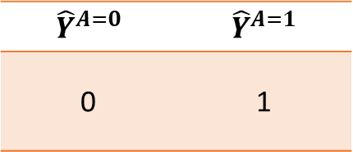
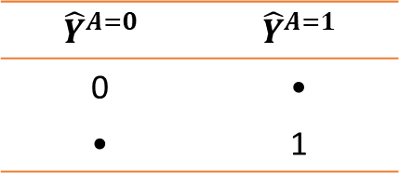
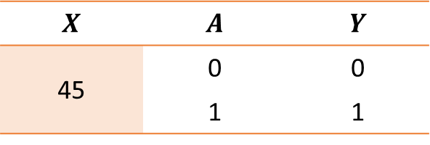
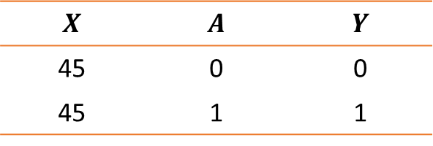
$\sim$Weight Models: Matching
Takes inspiration from Twin studies.
If all covariates are the same, then observations “merge” and the counterfactual outcomes become observed*
Epistemically convincing
$$X$$ | $$A$$ | $$Y$$
45 | 0 | 0
45 | 1 | 1
$${\hat{Y}}^{A=0}$$ | $${\hat{Y}}^{A=1}$$
0 | •
• | 1
Observed Data
$$X$$ | $$A$$ | $$Y$$
45 | 0 | 0
45 | 1 | 1
$${\hat{Y}}^{A=0}$$ | $${\hat{Y}}^{A=1}$$
0 | 1
Potential Outcome

Slide 34
$\sim$Weight Models: Matching
Advantage:
Epistemological: very intuitive / convincing
Statistical: avoids explicit modeling of response surface
Disadvantage:
Estimate effect on treated, not in the population
Notes:
Hides some of the response modeling under the hood of the similarity assignment. Non-parametric estimation of the outcome
We take just the controls that look like the treated. So the distribution of features we end up with is the distribution of the treated

Slide 35
$\sim$Weight Models: Matching
Advantage:
Epistemological: very intuitive / convincing
Statistical: avoids explicit modeling of response surface
Disadvantage:
Estimate effect on treated, not in the population
Sample inefficient

Slide 36
$\sim$Weight Models: Matching
Solution: use all units

Slide 37
$\sim$Weight Models: Matching
Solution: use all units
Match 1:many

Slide 38
$\sim$Weight Models: Matching
Solution: use all units
Match 1:many
Give each unit a proportional weight

Slide 39

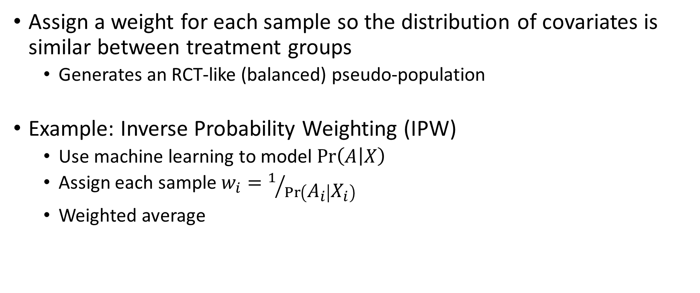
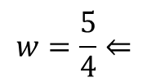

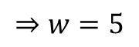

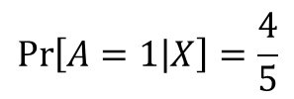
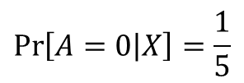


Weight Models
Assign a weight for each sample so the distribution of covariates is similar between treatment groups
Generates an RCT-like (balanced) pseudo-population
Example: Inverse Probability Weighting (IPW)
Use machine learning to model $\operatorname{Pr}\left(A | X\right)$
Assign each sample $w_{i}=1/{\operatorname{Pr}\left(A_{i} | X_{i}\right)}$
Weighted average
Treated
Untreated
$$w=\frac{5}{4}⇐$$
$$\operatorname{Pr}\left[A=1 | X\right]=\frac{4}{5}$$
$$\operatorname{Pr}\left[A=0 | X\right]=\frac{1}{5}$$
$$⇒w=5$$
Notes:
A weighted sample in which the features are distributed similarly and so the differences under this weighted distribution are only due to the treatment.
Pr[A|X] is a supervised learning task
If we were to compare the groups differences might have been rising just because there are more young people treated than untreated.
Pseudo population where the amount of young people in each group is the same so the effect of being male will cancel out and you’d be left with the effect of treatment
If 0 numerator: problem. redefine population of interest. Or embrace for model-based extrapolation (say a domain-expert oracle)

Slide 40
Weight Models
Assign a weight for each sample so the distribution of covariates is similar between treatment groups
Generates an RCT-like (balanced) pseudo-population
Example: Inverse Probability Weighting (IPW)
Use machine learning to model $\operatorname{Pr}\left(A | X\right)$
Assign each sample $w_{i}=1/{\operatorname{Pr}\left(A_{i} | X_{i}\right)}$
Weighted average
Treated
Untreated
$$w=\frac{5}{4}⇐$$
$$\operatorname{Pr}\left[A=1 | X\right]=\frac{4}{5}$$
$$\operatorname{Pr}\left[A=0 | X\right]=\frac{1}{5}$$
$$⇒w=5$$
Notes:
A weighted sample in which the features are distributed similarly and so the differences under this weighted distribution are only due to the treatment.
Pr[A|X] is a supervised learning task
If we were to compare the groups differences might have been rising just because there are more young people treated than untreated.
Pseudo population where the amount of young people in each group is the same so the effect of being male will cancel out and you’d be left with the effect of treatment
If 0 numerator: problem. redefine population of interest. Or embrace for model-based extrapolation (say a domain-expert oracle)

Slide 41
Weight Models
Assign a weight for each sample so the distribution of covariates is similar between treatment groups
Generates an RCT-like (balanced) pseudo-population
Example: Inverse Probability Weighting (IPW)
Up-weigh rare (surprising) samples
Low propensity score = Rare in group A and abundant in group B
A treated sample that was much more likely to be control holds valuable information about how it is to be a treated unit
Treatment is independent of covariates (unpredictable)
Treated
Untreated

Slide 42
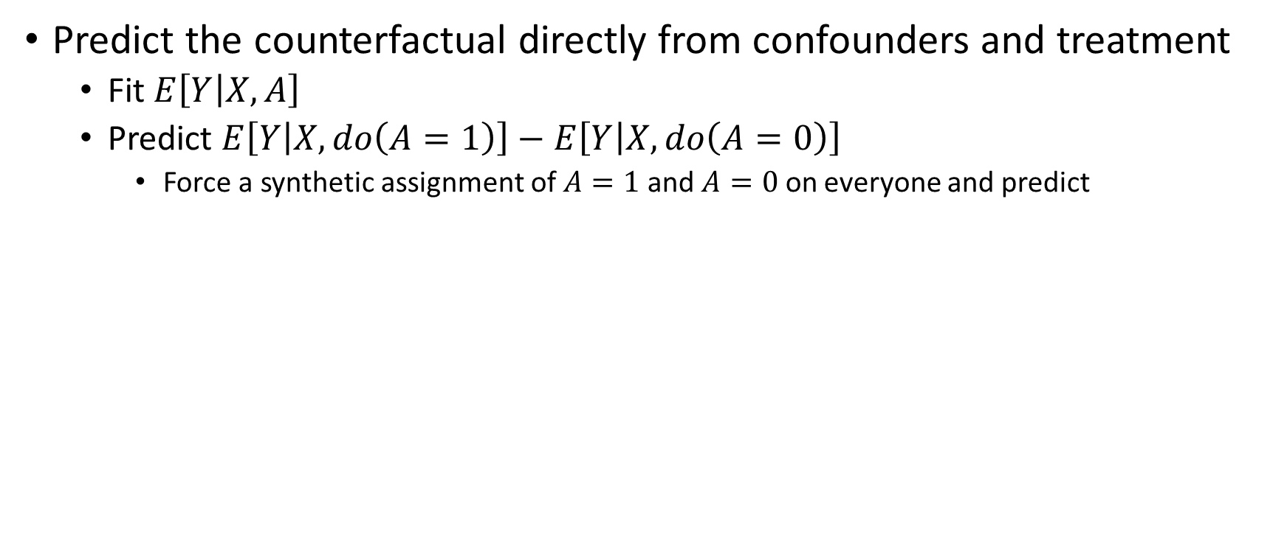
Outcome Models – meta-learners
Predict the counterfactual directly from confounders and treatment
Fit $E\left[Y | X,A\right]$
Predict $E\left[Y | X,do\left(A=1\right)\right]−E\left[Y | X,do\left(A=0\right)\right]$
Force a synthetic assignment of $A=1$ and $A=0$ on everyone and predict

Slide 43
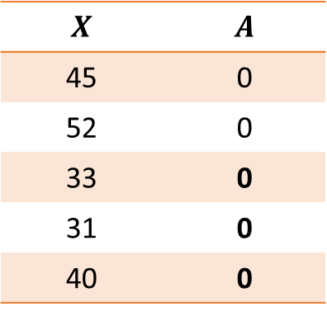

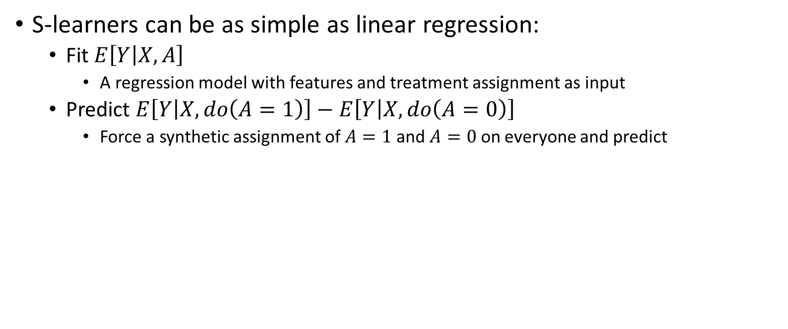
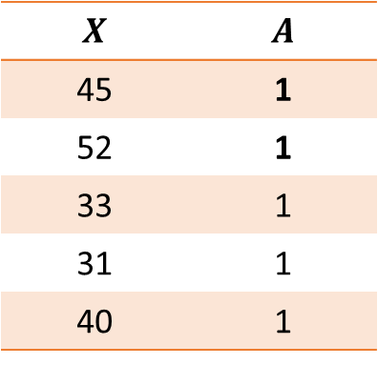
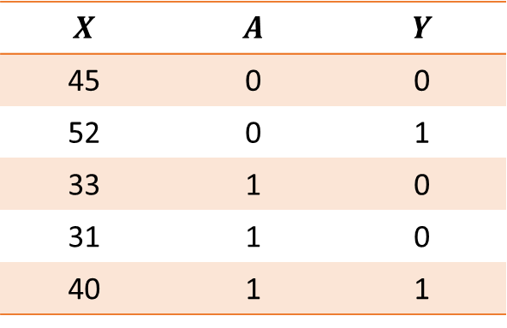

Outcome Models – meta-learners
S-learners can be as simple as linear regression:
Fit $E\left[Y | X,A\right]$
A regression model with features and treatment assignment as input
Predict $E\left[Y | X,do\left(A=1\right)\right]−E\left[Y | X,do\left(A=0\right)\right]$
Force a synthetic assignment of $A=1$ and $A=0$ on everyone and predict
Fit
Predict ${\hat{Y}}^{A=0}$
Predict ${\hat{Y}}^{A=1}$
$$X$$ | $$A$$ | $$Y$$
45 | 0 | 0
52 | 0 | 1
33 | 1 | 0
31 | 1 | 0
40 | 1 | 1
$$X$$ | $$A$$
45 | 0
52 | 0
33 | 0
31 | 0
40 | 0
$$X$$ | $$A$$
45 | 1
52 | 1
33 | 1
31 | 1
40 | 1
Observed Data

Slide 44
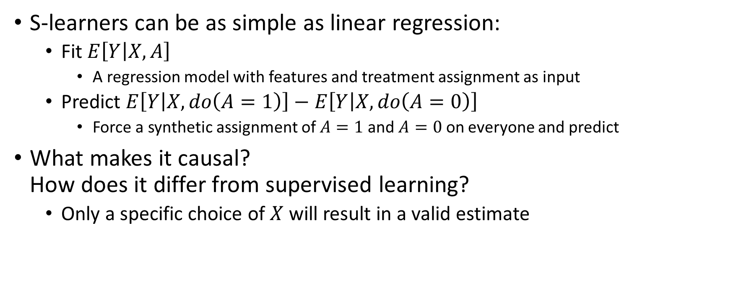
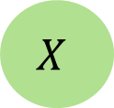
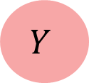

Outcome Models – meta-learners
S-learners can be as simple as linear regression:
Fit $E\left[Y | X,A\right]$
A regression model with features and treatment assignment as input
Predict $E\left[Y | X,do\left(A=1\right)\right]−E\left[Y | X,do\left(A=0\right)\right]$
Force a synthetic assignment of $A=1$ and $A=0$ on everyone and predict
What makes it causal? How does it differ from supervised learning?
Only a specific choice of $X$ will result in a valid estimate
$$X$$
$$A$$
$$Y$$

Slide 45


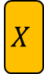
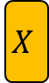


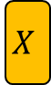

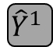



Outcome Models – meta-learners
Incorporating treatment information:
S-Learner – as an additional feature (single model)
Limited flexibility of treatment effect
T-Learner – as a task indicator (model per treatment)
Lower statistical power (smaller sample per model)
Hierarchical
Bayesian – multilevel hyper-prior sharing
Neural network – multi-task network
$$X$$
$${\hat{Y}}^{0}$$
Model 0
$${\hat{Y}}^{0}$$
Head 0
$${\hat{Y}}^{0}$$
Model
$$X$$
$$X$$
Base
$$A$$
$${\hat{Y}}^{1}$$
Model 1
$${\hat{Y}}^{1}$$
Head 1
$${\hat{Y}}^{1}$$
$$A$$
$$A$$
Notes:
S-learner – less flexible, better statistical power.
T-learner – more flexible, but less statistical power. Like a full treatment-covariate interaction model.
Hierarchical – the best of both worlds. Share mutual information at the start and only split to specialize later.

Slide 46
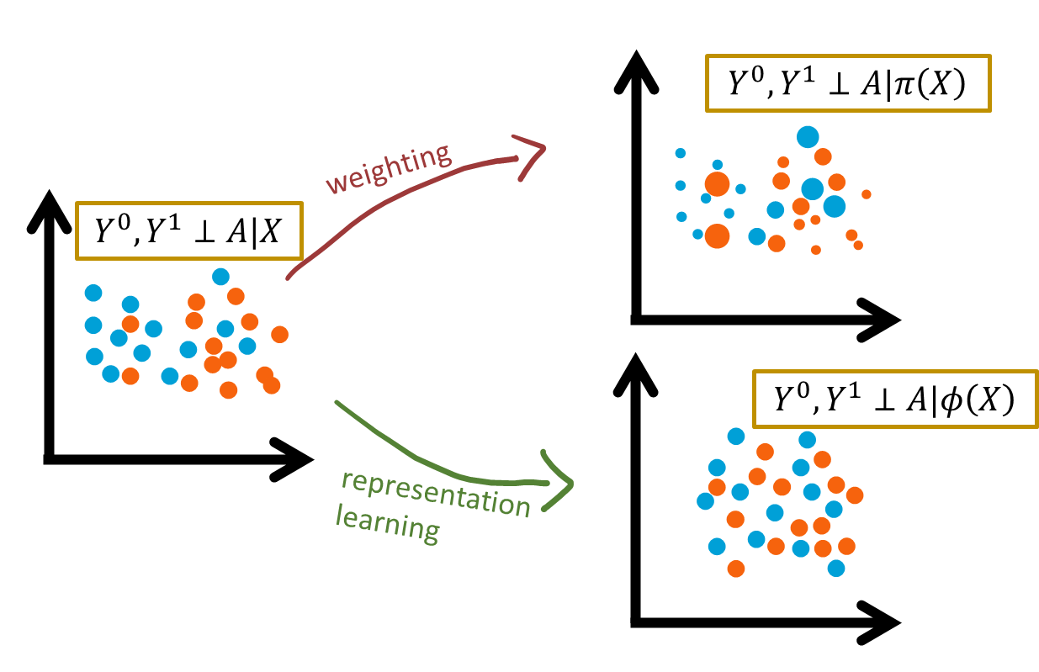
Outcome Models – with deep learning
Multi-task network design
Replace weighting with representation learning
Use DL to get a balanced representation between groups
Minimize distribution distance between group representations [auxiliary loss]
Use reverse gradients to create a representation that cannot predict the treatment
Force ignorability

Slide 47
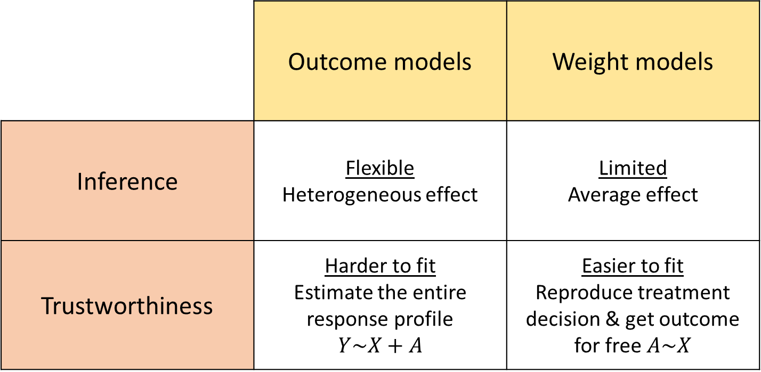
Modeling approach comparison
 | Outcome models | Weight models
Inference | Flexible Heterogeneous effect | Limited Average effect
Trustworthiness | Harder to fit Estimate the entire response profile $$Y\sim X+A$$ | Easier to fit Reproduce treatment decision & get outcome for free $A\sim X$

Slide 48
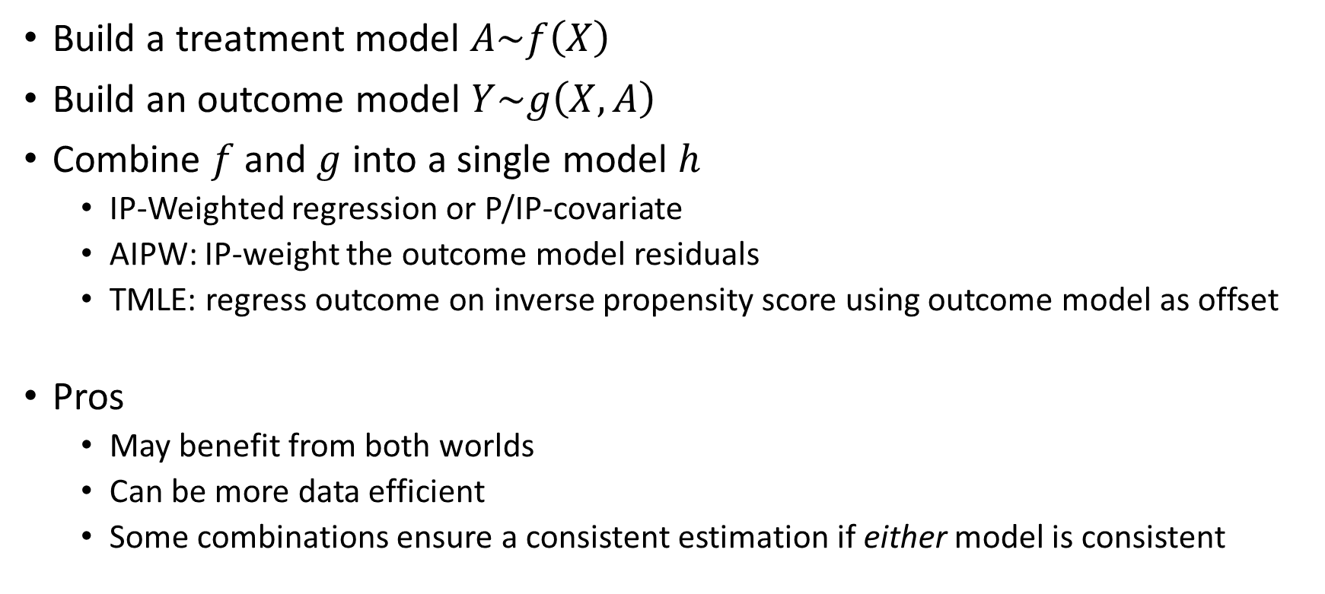
Doubly robust models
Build a treatment model $A\sim f\left(X\right)$
Build an outcome model $Y\sim g\left(X,A\right)$
Combine $f$ and $g$ into a single model $h$
IP-Weighted regression or P/IP-covariate
AIPW: IP-weight the outcome model residuals
TMLE: regress outcome on inverse propensity score using outcome model as offset
Pros
May benefit from both worlds
Can be more data efficient
Some combinations ensure a consistent estimation if either model is consistent

Slide 49
Doubly robust models – TMLE motivation
Optimizing $\underset{\text{prediction}}{\underbrace{E\left[Y | X,A\right]}} ⇏$ optimizing $\underset{\text{causal} \text{inference}}{\underbrace{E\left[Y | X,A=1\right]−E\left[Y | X,A=0\right]}}$
Not the same parameter of interest
Supervised learning will not directly result in causal effect estimation
If you fit
A dog classifier 🐶 and
A cat classifier 🐱
You don’t expect them to tell the differences between dogs and cats
Floppy ears, pointed face, etc.
Not their primary objective when optimizing
Notes:
Extreme case: ignore the treatment variable completely because it is not predictive of the outcome, but that doesn’t mean there’s no effect.

Slide 50
Causallib
Flexibly estimating causal effect and predicting counterfactuals in Python

Slide 51
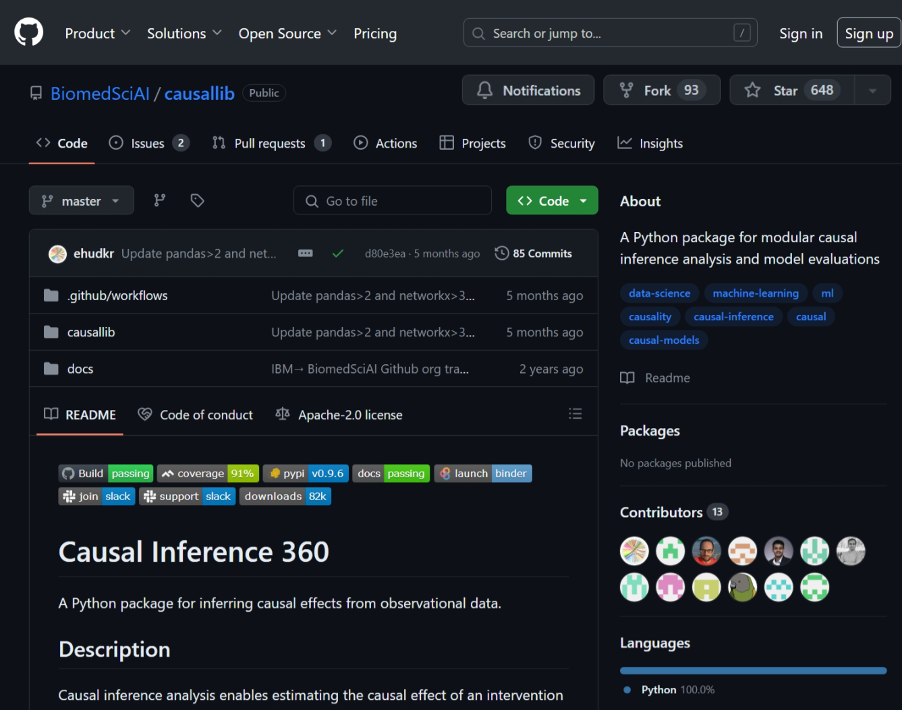
Causallib
Flexibly estimating causal effect and predicting counterfactuals in Python
Notes:
This is how you estimate causal effects in principle,
Which brings us to causallib, and how to estimate causal effects in practice.

Slide 52
Causallib
Open-source Python package
A one-stop-shop for causal inference modelling
Estimation (survival, too), evaluation, variable selection, data…
Domain-agnostic
Flexible estimation
Mix and match arbitrary plug-in estimator into interchangeable causal models
Scikit-learn inspired
Familiar feeling for ML practitioners
Available on PyPI: pip install causallib

Slide 53
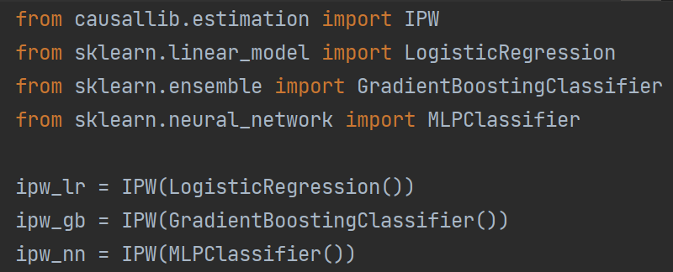
Causallib: Principles
Flexible
Leverage arbitrarily complex machine-learning models
Mix and match between causal models and machine learning estimators

Slide 54
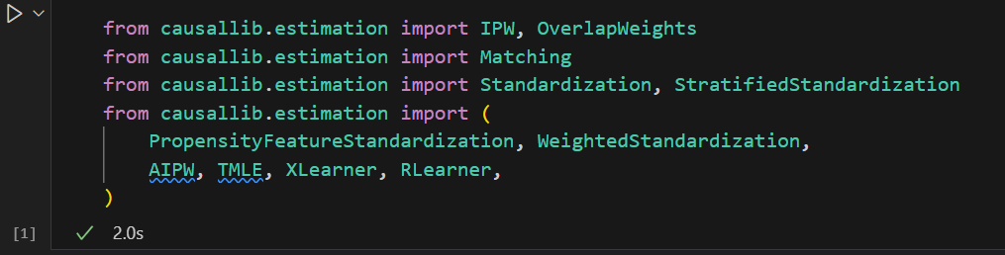
Causallib: Principles
Unifies many models under the same roof and API
Interchangeable causal models
Mix and match between causal models and machine learning estimators

Slide 55
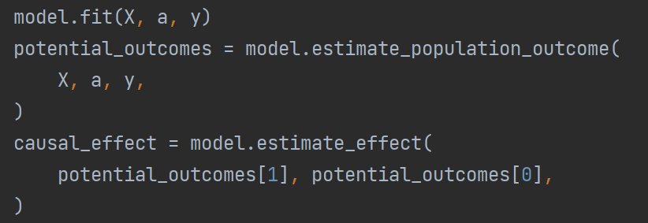
Causallib: Principles
Unifies many models under the same roof and API
A scikit-learn inspired fit()\predict()-like, API
predict() is not well-defined in our context, we prefer to be explicit:
estimate_*_outcome()
estimate_effect()
Estimating effects in two steps: predict potential outcomes and use them for effect.

Slide 56
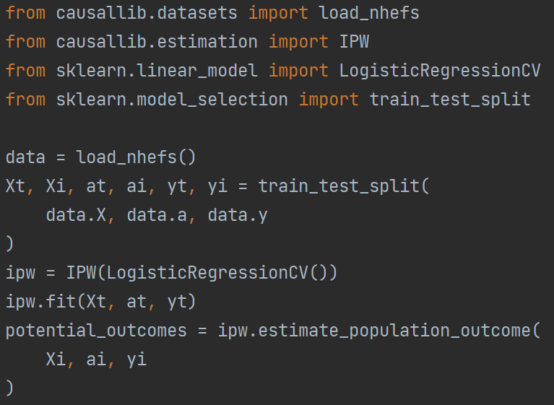
Causallib: Principles
Estimate on out-of-box samples
Avoids “double dipping”
Especially important for arbitrary complex models

Slide 57
Evaluation

Slide 58
Causallib: Evaluation
Full evaluation of causal effect is impossible
No ground truth labels for counterfactual outcomes
“The Fundamental Problem of Causal Inference”
Proxy tests
Weight models: balance tests
Outcome models: residual symmetry
Evaluation suite in causallib
Graphical
Numerical for model selection

Slide 59
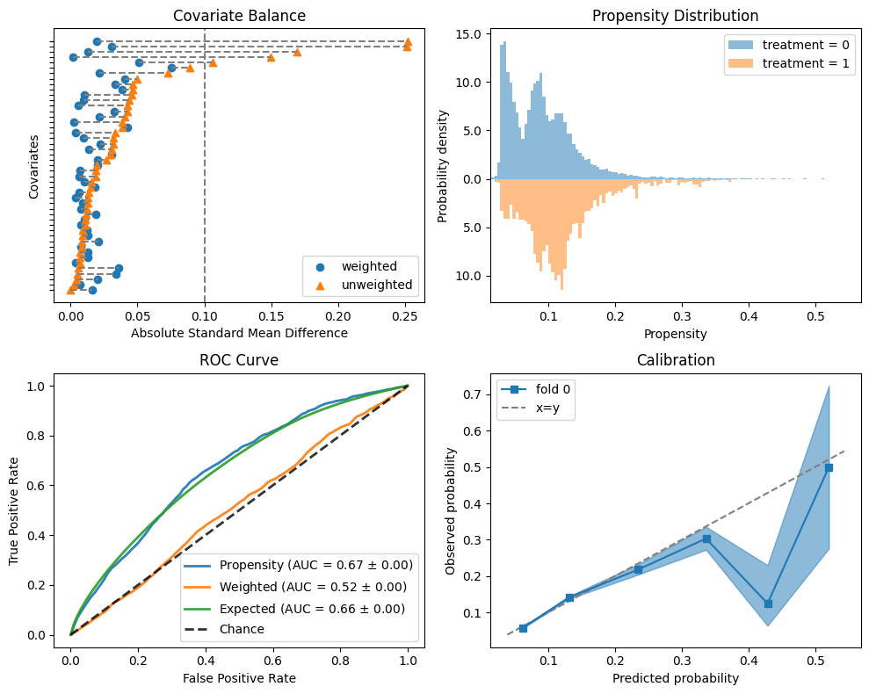
Causallib
Evaluating IPW

Slide 60
Jupyter Notebook demo + exercise
TODO ADD LINK
Notes:
Without further ado,
https://notebooks.res.ibm.com/user/ehud.karavani@ibm.com/lab

Slide 61
Regroup

Slide 62
Questions?

Slide 63
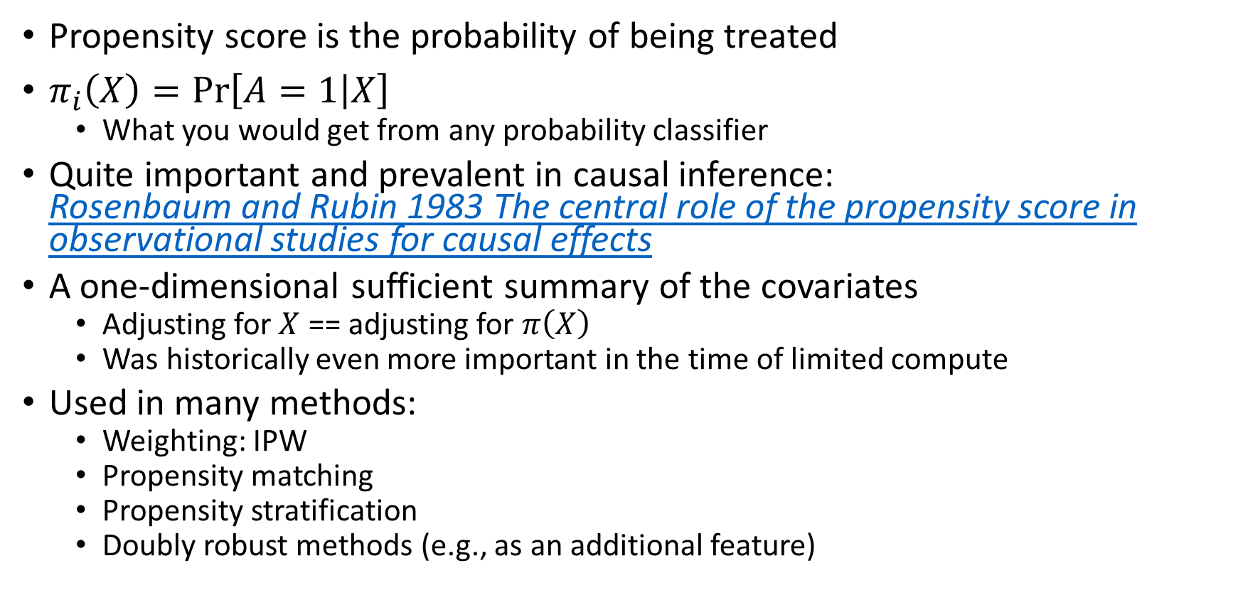
Question for chat: propensity scores
Propensity score is the probability of being treated
$π_{i}\left(X\right)=\operatorname{Pr}\left[A=1 | X\right]$
What you would get from any probability classifier
Quite important and prevalent in causal inference: Rosenbaum and Rubin 1983 The central role of the propensity score in observational studies for causal effects
A one-dimensional sufficient summary of the covariates
Adjusting for $X$ == adjusting for $π\left(X\right)$
Was historically even more important in the time of limited compute
Used in many methods:
Weighting: IPW
Propensity matching
Propensity stratification
Doubly robust methods (e.g., as an additional feature)

Slide 64
Flexible causal modeling with causallib
Mix and match plug-in estimators with interchangeable causal models
X, a, y = get_data()
model = IPW( LogisticRegression()
).fit(
X, a, y
).estimate_population_outcome(
X, a, y
)

Slide 65
Flexible causal modeling with causallib
Mix and match plug-in estimators with interchangeable causal models
X, a, y = get_data()
model = IPW( LogisticRegressionCV()
).fit(
X, a, y
).estimate_population_outcome(
X, a, y
)

Slide 66
Flexible causal modeling with causallib
Mix and match plug-in estimators with interchangeable causal models
X, a, y = get_data()
model = IPW( make_pipeline(
StandardScaler(),
SplineTranformer(),
LogisticRegressionCV()
)
).fit(
X, a, y
).estimate_population_outcome(
X, a, y
)

Slide 67
Flexible causal modeling with causallib
Mix and match plug-in estimators with interchangeable causal models
X, a, y = get_data()
model = IPW( GradientBoostingTreesClassifier()
).fit(
X, a, y
).estimate_population_outcome(
X, a, y
)

Slide 68
Flexible causal modeling with causallib
Mix and match plug-in estimators with interchangeable causal models
X, a, y = get_data()
model = IPW( GridSearchCV(
GradientBoostingTreesClassifier()
param_grid={ "n_estimators": [20, 50, 100, 200], },
)
).fit(
X, a, y
).estimate_population_outcome(
X, a, y
)

Slide 69
Flexible causal modeling with causallib
Mix and match plug-in estimators with interchangeable causal models
X, a, y = get_data()
model = Standardization( GridSearchCV(
GradientBoostingTreesClassifier()
param_grid={ "n_estimators": [20, 50, 100, 200], },
)
).fit(
X, a, y
).estimate_population_outcome(
X, a, y
)

Slide 70
Flexible causal modeling with causallib
Mix and match plug-in estimators with interchangeable causal models
X, a, y = get_data()
model = StratifiedStandardization( GridSearchCV(
GradientBoostingTreesClassifier()
param_grid={ "n_estimators": [20, 50, 100, 200], },
)
).fit(
X, a, y
).estimate_population_outcome(
X, a, y
)

Slide 71
Flexible causal modeling with causallib
Mix and match plug-in estimators with interchangeable causal models
X, a, y = get_data()
model = CausalGridSearchCV( IPW(GradientBoostingClassifier()), param_grid={ "clip_min": [0.0001, 0.001, 0.01], "learner__n_estimators": [20, 50, 100, 200], },
scoring=[ "weighted_roc_auc_error", "covariate_balancing_error", "ICI", ], refit="weighted_roc_auc_error",
).fit(X, a, y)

Slide 72
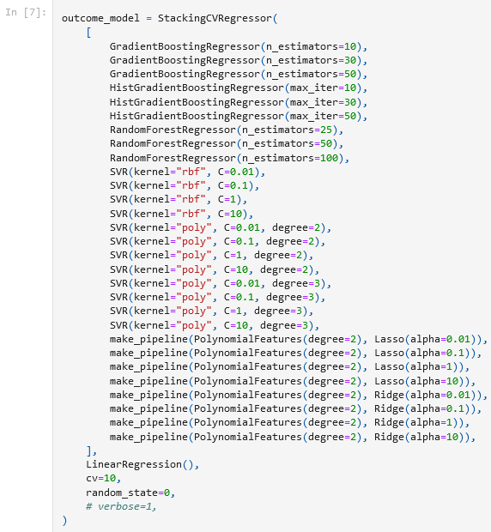
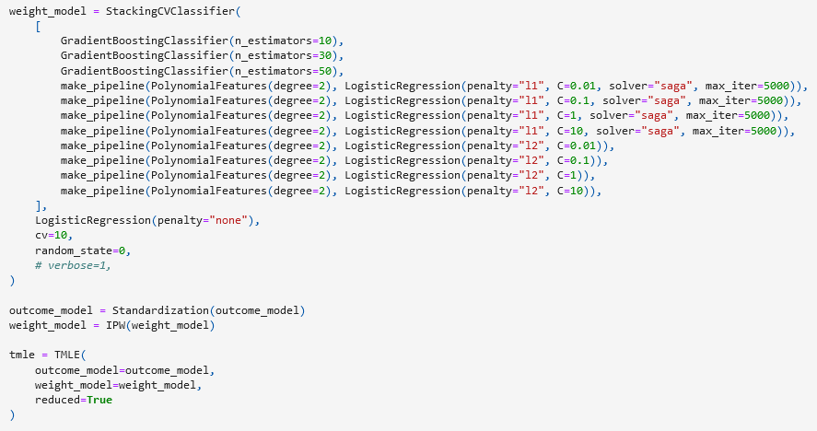
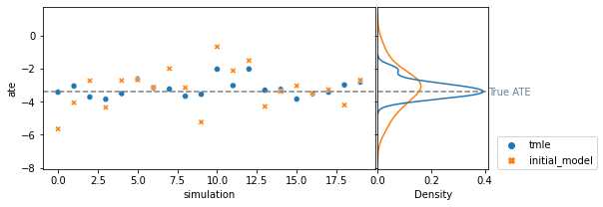
https://github.com/IBM/causallib/blob/master/examples/TMLE.ipynb

Slide 73
Identification
When correlation does imply causation

Slide 74
Identification, estimation
We heavily focused on estimation techniques but it’s important to remember that causality is part estimation part identification.
Estimation works within the data
Identification is outside the data (e.g., domain knowledge)
Identification is our justification to make the leap of faith interpreting the associations we derived from the data as causal effects
Identification translates the hypothetical potential outcomes to measurable quantities from the data

Slide 75



Causal identification
Recall $Y^{0},Y^{1}$ are hypothetical quantities of the multiverse
How do we translate them into measurable quantities
When does
$Y^{A=0}=\operatorname{Pr}\left[Y | A=0\right]$
$Y^{A=1}=\operatorname{Pr}\left[Y | A=1\right]$
What we want
What we have
The outcome had we set $A=a$
The outcome among those who had $A=a$

Slide 76


Randomized Control Trials
Since we can’t access the multiverse, the next best thing:
Randomized control trials
Gather many people, randomly assign them to a treatment or placebo arm.
Substitute
$Y^{A=0}=\operatorname{Pr}\left[Y | A=0\right]$
$Y^{A=1}=\operatorname{Pr}\left[Y | A=1\right]$
Gold standard for causal effects
Not always feasible:
Ethics, cost, time, generalization…
Notes:
In RCT you can simply take the average and it works (ideally speaking!)

Slide 77


Observational studies
Since we can’t always randomize and intervene, the next best thing:
Observational studies
Data collected from daily processes, abundant
Prone to bias
$Y^{A=0}≠\operatorname{Pr}\left[Y | A=0\right]$
$Y^{A=1}≠\operatorname{Pr}\left[Y | A=1\right]$
“Correlation does not imply causation”
But there are formal mathematical conditions in which this is possible
The 3 causal assumptions:
Unconfoundedness
Overlap
Consistency

Slide 78



Assumption 1: unconfoundedness
Confounders are variables that affect both the assignment and the outcome
Creating systematic differences between groups
AKA exchangeability, ignorability
Need to account for all confounding factors
Treated
Untreated
Debt payment
Average “effect”
Days late
Days late

Slide 79



Assumption 2: overlap
Everyone have some chance to be in both treatment groups
AKA common support, positivity, covariate overlap
Treated
Untreated
Do birth control pills
reduce headaches?
The effect on “people” cannot be estimated from the data, because we can’t use the data to estimate what will happen to treated males

Slide 80
Assumption 2: overlap
Everyone have some chance to be in both treatment groups
External validity: Overlap regions suggest where we might expect our effect estimation to generalize beyond the dataset
Extrapolation: No overlap means the model will extrapolate the prediction beyond what is grounded in the data

Slide 81




Assumption 2: overlap
Testing
Checking the support of high-dimensional feature distributions is challenging
Though possible: Karavani, Bak, and Shimoni 2019
Propensity scores, as a scalar summary of the feature space allow us to compare univariate distributions

Slide 82

Assumption 3: causal consistency
Interventions need to be well-defined and manipulatable
Weight $↓$
Health

Slide 83



Assumption 3: causal consistency
Interventions need to be well-defined and manipulatable
Weight $↓$
Health
Notes:
Also: who’s the control group?

Slide 84

Bonus: why RCTs are unbiased
RCTs randomly assign an intervention with equal probability
Unconfoundedness
Well-defined action
Overlap
Treated
Untreated
Treatment and covariates are independent
Age

Slide 85
Emulating RCTs with observational data
RCTs randomly assign an intervention with equal probability
Good observational studies will emulate a hypothetical RCT
Unconfoundedness
Well-defined action
Overlap
Adjust for confounding factors to emulate randomization
Choose a good intervention to model
Verify feature distribution is similar across groups

Slide 86
Causation = Correlation + Logic
Notes:
Getting correlations is easy. Hypothesizing whether these correlations are causal is hard.
Require tight cooperation between those knowing the domain and those knowing the methods.

Slide 87
Causation = Correlation + Logic
Estimation
Identification
Notes:
Getting correlations is easy. Hypothesizing whether these correlations are causal is hard.
Require tight cooperation between those knowing the domain and those knowing the methods.

Slide 88
Causal inference in the age of deep-learning, transformers, LLMs, and Foundation Models
Model inputs is now a lost art
Pre-DL machine learning heavily focused on feature engineering and model inputs
The Cambrian DL Explosion (circa 2012) made expertise in feature engineer degenerate
Kitchen sink of raw data “and let the model solve it”
Very different from the approach for causal inference
Nonetheless, causality in images is ill-defined (intervention on pixel space?) and requires DL-based representation learning
DL/transformer architecture as better function approximators
Recall we need to capture the functional form of the confounding in order to eliminate residual confounding
May require some architecture/training adjustments to enforce exchangeability
LLMs as “knowledge-based experts” to solicit confounders from

Slide 89
Summary: Causal Inference
Evaluate policies directly
Instead of translating into descriptive/predictive tasks
Estimate the impact of interventions
Eliminate the effect of confounders
Isolate the effect of treatment
Requires a careful combination of
Domain knowledge
Study design
Statistical methods
Emulate an ideal hypothetical randomized trial from available data
Notes:
We started with the motivation of evaluation policy directly: instead of predicting who is high risk for churn and sending them coupons, implicitly assuming coupons will keep them, just estimate the effect of sending coupons directly.

Slide 90
Summary: Causal Inference
Causal models borrow information across groups to extrapolate counterfactual predictions
Weight models model the treatment assignment
Outcome models model the response surface directly
Doubly robust models combine the two
Direct performance evaluation is impossible
Proxies for evaluating balance and overlap do exist
If possible:
experiment to validate effects
Recreate known experiments and extend them

Slide 91
Summary: Causal Inference with causallib
causallib is a one-stop-shop for causal inference modelling
Domain-agnostic
Flexible
Mix and match arbitrary plug-in estimator into interchangeable causal models
Use complex models as easily as simple ones
Familiar feeling for ML practitioners

Slide 92



ehudk@ibm.com
Feel free to reach out:
ehudk

Slide 93

Notes:
Discussion

